Slide 1

Embedded ECG Heart Monitor
By: Mohamed A. Abdel Hamed
Supervised by: Dr. Shalan
GitHub Repo: https://github.com/Oschart/Embedded-Heart-Monitor

Slide 2
01
02
OUTLINE
Overview
Features & User Guide
03
04
05
Demo Runs
Design & Implementation
Future Development
What is this project about?
System functionalities
06
References
How was the system realized?
Examples of the system in action
What can be improved?

Slide 3
01
Overview
What is this project about?

Slide 4
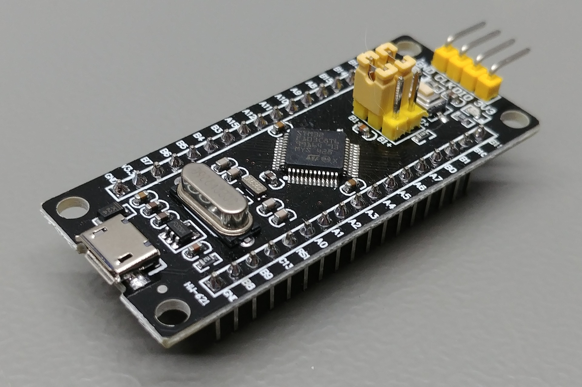
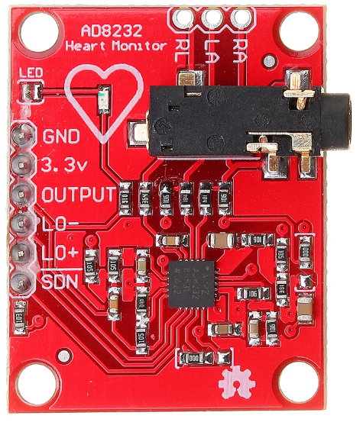
OVERVIEW
Description: Real-time ECG Heart Monitor
System consists of two parts/sides:
Embedded system on an STM32 chip
Desktop application
Hardware used:
STM32F1 Black Pill microcontroller
AD8232 ECG Sensor

Slide 5



OVERVIEW (cont.)
Programming languages used:
Black Pill app: developed in C
PC app: developed using Python 3.8.2
Development software used:
Black Pill app: Keil uVision IDE + CubeMX
PC app: pySerial + matplotlib + pySimpleGUI

Slide 6
02
Features & User Guide
System functionalities and how to use them

Slide 7
Features
Sampling Rate Control
ECG Data Plotting & HR Calculation
Baud Rate Control & Port Selection
Heart beat ECG data is sampled and plotted in real-time
User can control the ECG sampling rate
(1 – 1000 SPS)
Initially, the user can select which port to bind to, and with what baud rate

Slide 8
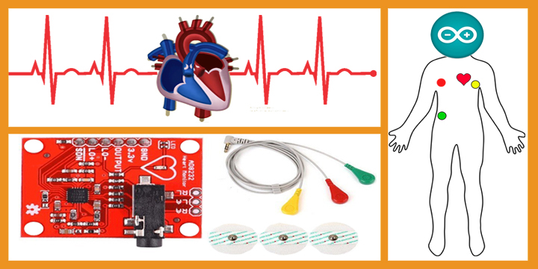
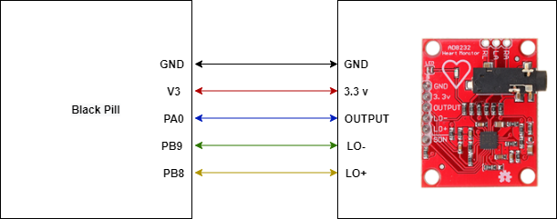
User Guide
This guide assumes the user has the hardware described before (along with a means to download the hex code to the uC) in addition to the required software (including the Python packages).
Below are the steps to use the system:
Make sure all connections are as shown below.
Download the hex code to the Black Pill uC (e.g. though serial programming)
Put the uC into operation mode (if you’re using SP) and click the Reset button.
Go to the “main_app” directory and run the following command “python main.py”
The remaining can be configured through GUI panels

Slide 9
03
Implementation
How was the system realized?

Slide 10
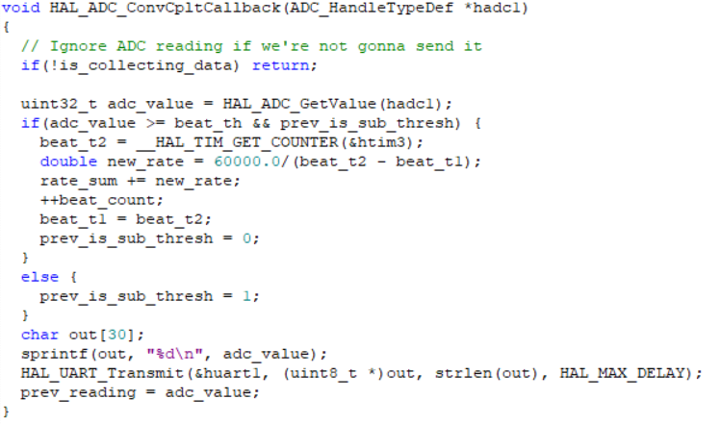
Implementation
1. Sensor Output Sampling:
Done using the Black Pill internal ADC1 (IN0)
Sampling triggering is controlled by the GPTM TIM2 in interrupt mode
Sample size = 12 bits
Heart beat counting and transmission of readings is done in the ADC ISR callback.

Slide 11
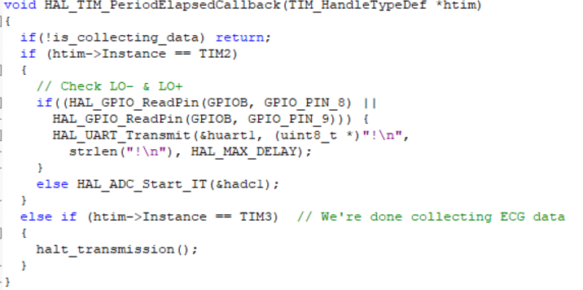
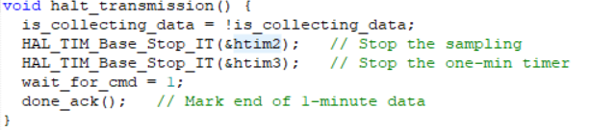
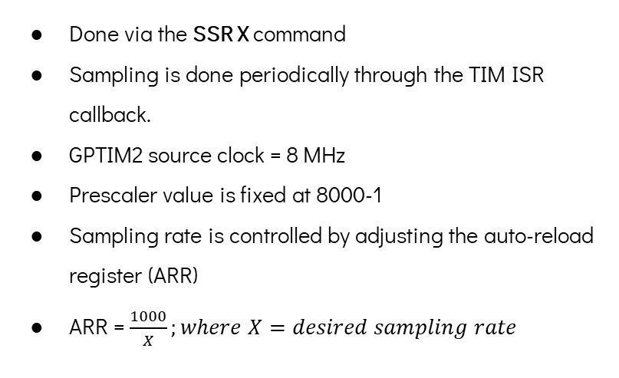
Implementation (cont.)
2. Sampling Rate:
Done via the SSR X command
Sampling is done periodically through the TIM ISR callback.
GPTIM2 source clock = 8 MHz
Prescaler value is fixed at 8000-1
Sampling rate is controlled by adjusting the auto-reload register (ARR)
ARR = $\frac{1000}{X};where X=desired sampling rate$

Slide 12
Implementation (cont.)
3. ECG Data Collection:
Done via the C1MWD command
The 1 minute is marked through the TIM ISR callback.
GPTIM3 source clock = 8 MHz
Prescaler value is fixed at 8000-1
ARR is fixed at 60000-1 to get a minute timer
The C1MWD command triggers the data collection mode and starts TIM2 for sampling

Slide 13
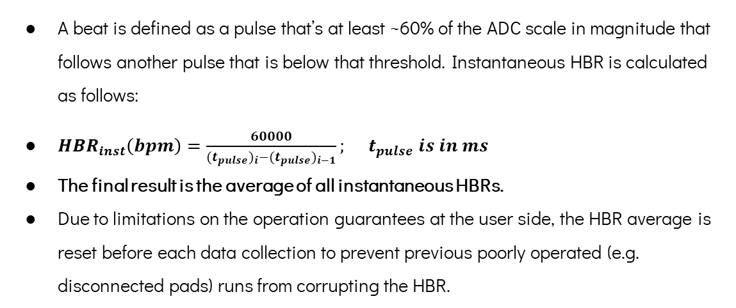
Implementation (cont.)
4. Heart Beat Rate Calculation:
A beat is defined as a pulse that’s at least ~60% of the ADC scale in magnitude that follows another pulse that is below that threshold. Instantaneous HBR is calculated as follows:
$HBR_{inst}\left(bpm\right)=\frac{60000}{{(t_{pulse})}_{i}−{(t_{pulse})}_{i−1}}; t_{pulse} is in ms$
The final result is the average of all instantaneous HBRs.
Due to limitations on the operation guarantees at the user side, the HBR average is reset before each data collection to prevent previous poorly operated (e.g. disconnected pads) runs from corrupting the HBR.

Slide 14
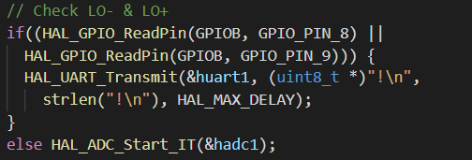
Implementation (cont.)
5. Leads-off Detection:
This is done by digitally reading the GPIO pin value of the LO+ & LO- sensor signals.
If they’re high, the microcontroller sends a special pre-set character ‘!’ to signal the PC app to flatten the plot at that point.

Slide 15
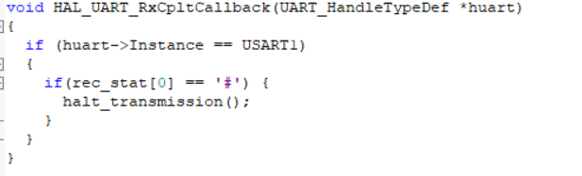
Implementation (cont.)
6. Premature Data Collection Cancelling:
This is achieved by sending a pre-agreed character ‘#’ to the uC to signal it to stop. This character is received in UART interrupt mode because we cannot afford to block for an interruption signal during non-stop transmission.

Slide 16
Implementation (cont.)
uC Commands:
SSR X | Set Sample Rate to X samples per second (1 – 1000)
C1MWD | Collect 1 Minute Worth of Data: starts data collection and plotting mode for 1 minute, during which the user cannot insert any new commands
RHBR | Report Heart Beat Rate
EXIT | Terminates the app

Slide 17
04
Demo Run
Examples of the system in action

Slide 18
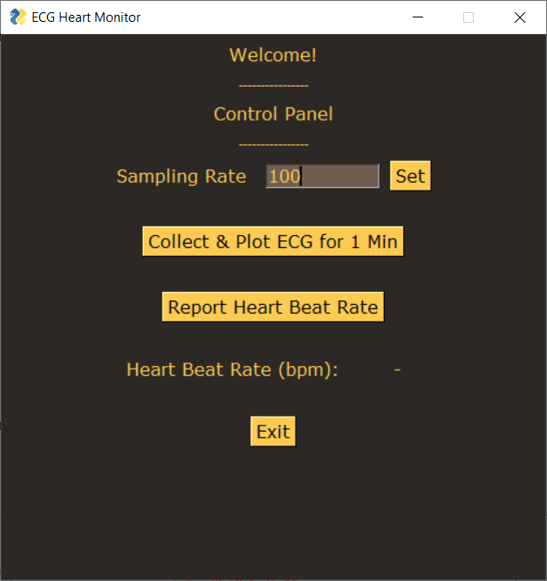
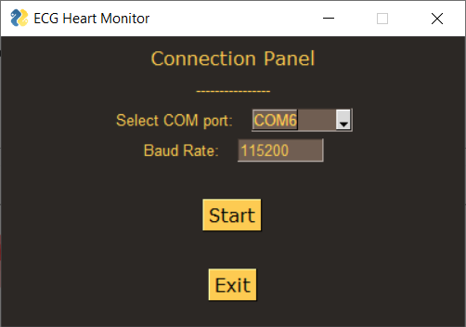
Demo Runs
I. Connection settings:
II. Sampling rate:

Slide 19
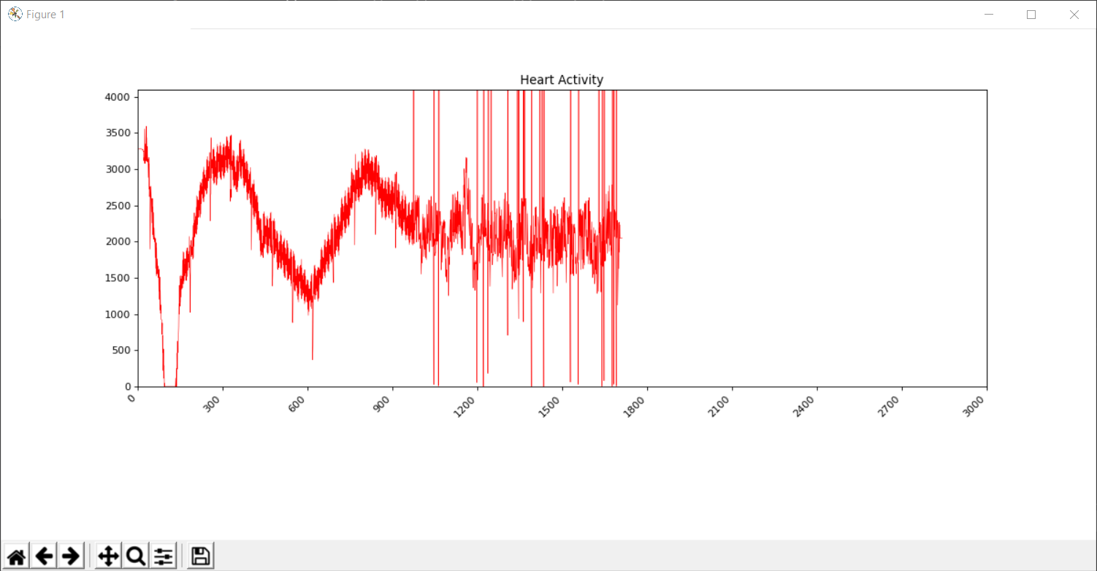
Demo Runs
III. Data collection & plotting

Slide 20

Demo Runs
IV. Heart beat rate:
Note: HBR is staggeringly high due to worn-out pads which cause great disturbance in the sensor output.

Slide 21
05
Future Development
What can be improved?

Slide 22
Future Development
The following could be a potential improvement on the presented system:
Using DMA for managing ADC conversions instead of interrupts
Utilizing the SDN (shut down) signal of the AD8232 sensor to save power when we’re not sampling its output.
Using a smoother technique for updating graph data in real-time
Adding a layer of fault tolerance around port binding in case of failures to connect to UART.

Slide 23
References
AD8232 Sensor Datasheet
STM32F1 Datasheet
https://learn.sparkfun.com/tutorials/graph-sensor-data-with-python-and-matplotlib/update-a-graph-in-real-time
https://pythonhosted.org/pyserial/index.html

Slide 24
Thank You

